Slide 1
Forecasting Analytics
Session 4

Slide 2
Modeling the random component
A time series is said to be stationary if
It has a constant mean
Autocorrelation (ACF) at lag k is the same at all parts of the series
Basic models for stationary time series
Autoregressive (AR) model
Moving average (MA) model
Autoregressive Moving Average (ARMA) model

Slide 3
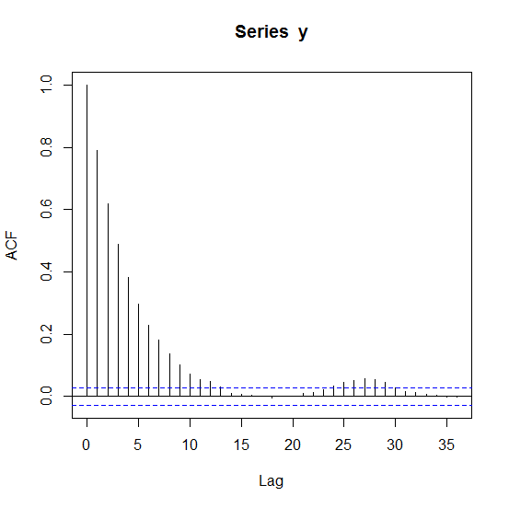
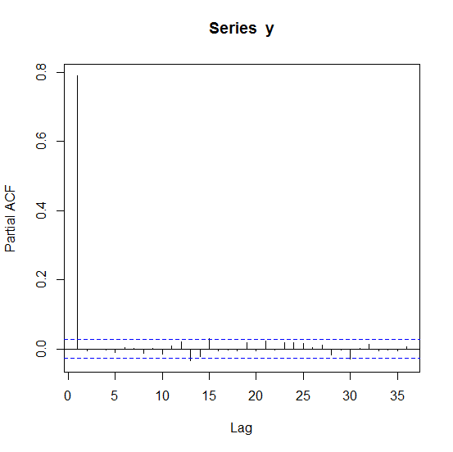
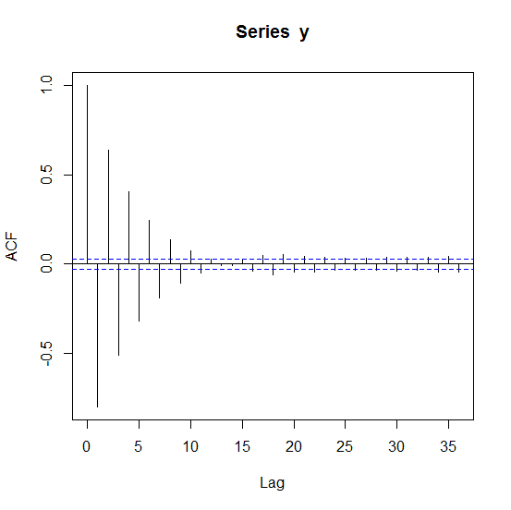
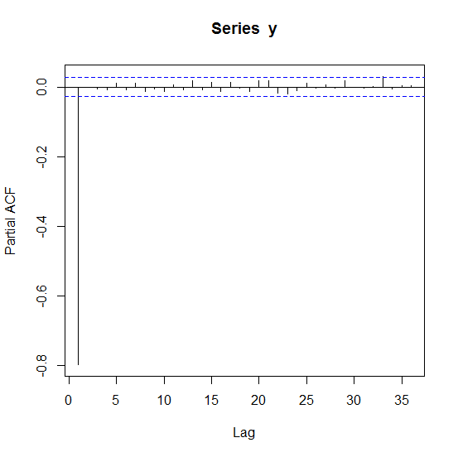
AR(1) model
Y_{t} = φ₀ + φ₁Y_{t – 1} + ε_{t} , ε_{t} white noise
φ₁ = 0.8
φ₁ = – 0.8
ACF plot
PACF (partial ACF) plot

Slide 4
AR(p) model
Y_{t} = φ₀ + φ₁Y_{t – 1} + φ₂Y_{t – 2} + … + φ_{p}Y_{t – p} + ε_{t} , ε_{t} white noise
Such a model has non-zero ACF at all lags
However, only the first p PACFs are non-zero; the rest are zero
If PACF plot shows large PACFs only at a few lags, then AR model is appropriate
If an AR model is to be fitted, the parameters φ₀, φ₁, φ₂,…, φ_{p} have to be estimated from the data, under the restriction that the estimated values should guarantee a stationary process

Slide 5
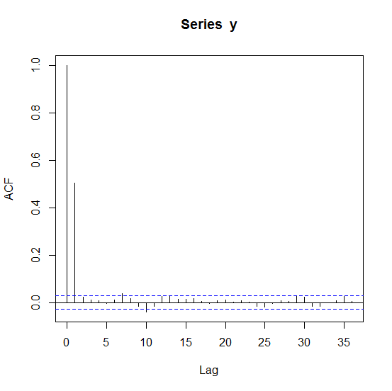
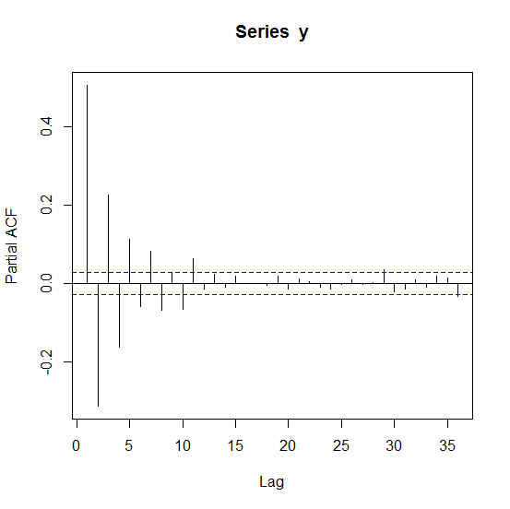
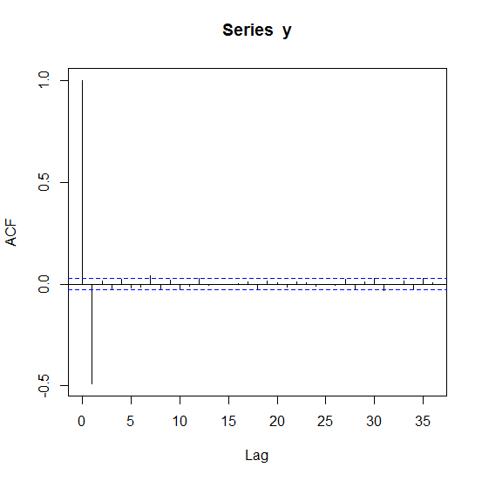
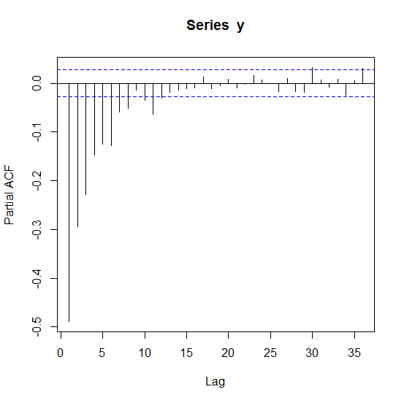
MA(1) model
Y_{t} = θ₀ + ε_{t} + θ₁ ε_{t – 1} , ε_{t} white noise
θ₁ = 0.8
θ₁ = – 0.8
ACF plot
PACF (partial ACF) plot

Slide 6
MA(q) model
Y_{t} = θ₀ + ε_{t} + θ₁ ε_{t – 1} + θ₂ ε_{t – 2} + … + θ_{q} ε_{t – q} , ε_{t} white noise
Such a model has non-zero PACF at all lags
However, only the first q ACFs are non-zero; the rest are zero
If ACF plot shows large ACFs only at a few lags, then MA model is appropriate
If an MA model is to be fitted, the parameters θ₀, θ₁, θ₂,…, θ_{q} have to be estimated from the data

Slide 7
ARMA(p,q) model
Y_{t} = φ₀ + φ₁Y_{t – 1} + φ₂Y_{t – 2} + … + φ_{p}Y_{t – p}
+ ε_{t} + θ₁ ε_{t – 1} + θ₂ ε_{t – 2} + … + θ_{q} ε_{t – q} , ε_{t} white noise
Such a model has non-zero ACF and non-zero PACF at all lags
If an ARMA(p,q) model is to be fitted, the parameters φ₀, φ₁, φ₂,…, φ_{p}, θ₁, θ₂,…, θ_{q} have to be estimated from the data, under the restriction that the estimated values produce a stationary process
AR(p) is ARMA(p,0)
MA(q) is ARMA(0,q)

Slide 8
ARIMA(p,d,q) model
If d-times differenced series is ARMA(p,q), then original series is said to be ARIMA(p,d,q).
ARIMA stands for ‘Autoregressive Integrated Moving average’.
If W_{t} is the differenced version of Y_{t}, i.e., W_{t} = Y_{t} – Y_{t – 1},
then Y_{t} can be written as
Y_{t} = W_{t} + W_{t – 1} + W_{t – 2} + W_{t – 3} + … .
Thus, the series Y_{t} is an ‘integrated’ (opposite of ‘differenced’) version of the series W_{t}.
If Y_{t} is ARIMA(p,d,q), it is non-stationary.
However, its d-times differenced version, an ARMA(p,q) process, can be stationary.

Slide 9
Box-Jenkins ARIMA model-building
Model identification
If the time plot ‘looks’ non-stationary, difference it until the plot looks stationary
Look at ACF and PACF plots for possible clue on model order (p, q)
When in doubt (regarding choice of p and q), use the principle of parsimony: A simple model is better than a complex model
Estimate model parameters
Check residuals for health of model
Iterate if necessary
Forecast using the fitted model

Slide 10
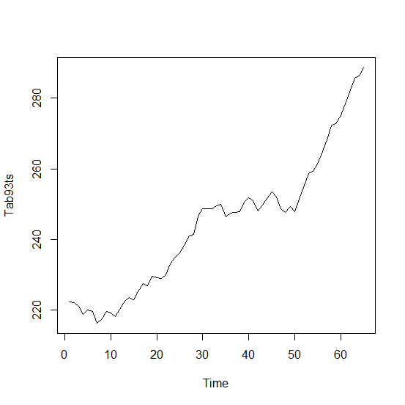
Example: Dow-Jones transportation index, daily closing averages (Tab9-3)
Plot ‘looks’ non-stationary (mean is not stable)
Don’t bother to plot ACF or PACF; try differencing

Slide 11
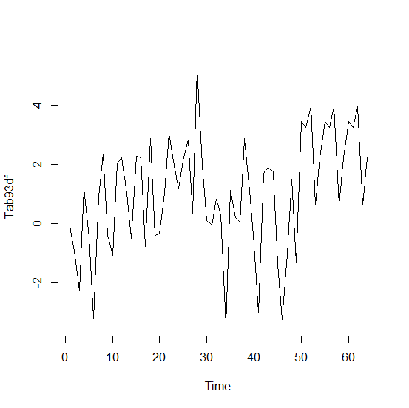
Time plot of transportation index data, differenced once
Looks more stationary, settle for this for now
Plot ACF/PACF

Slide 12
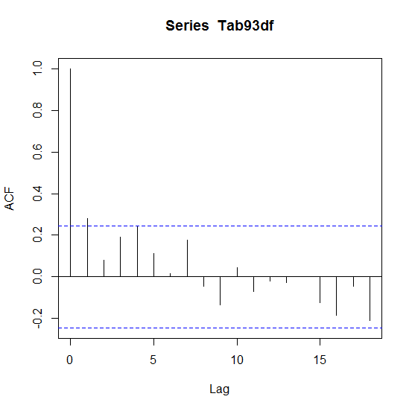
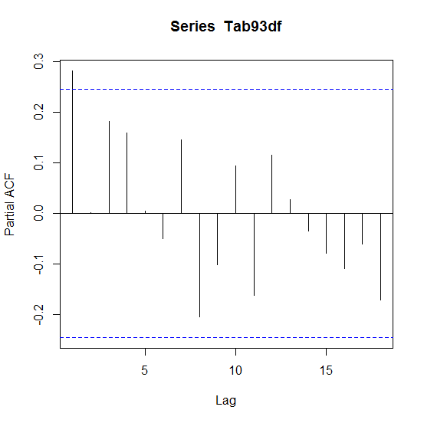
ACF/PACF plot of transportation index data, differenced once
Only one significant ACF, suggesting MA(1) model
Only one significant PACF, suggesting AR(1) model

Slide 13
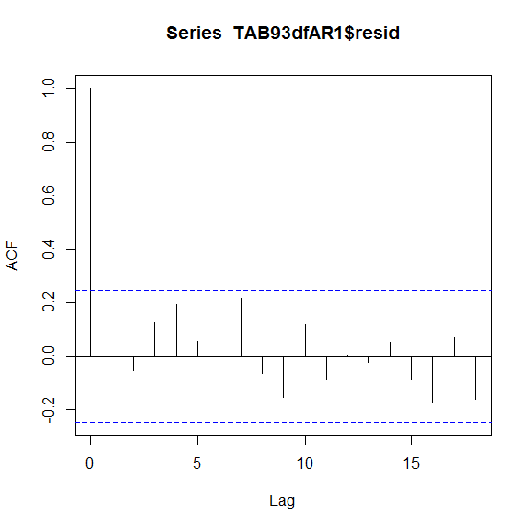
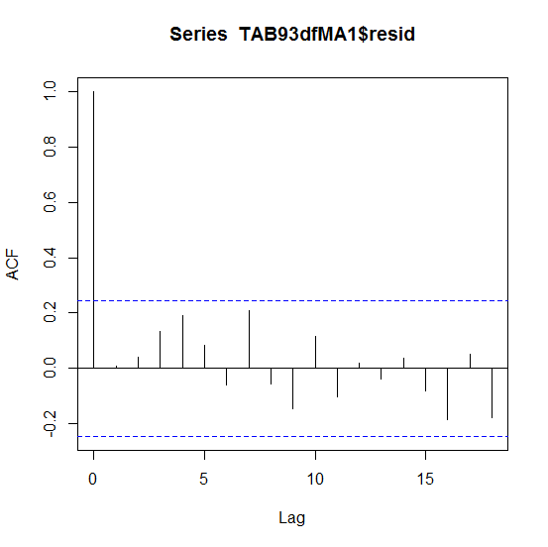
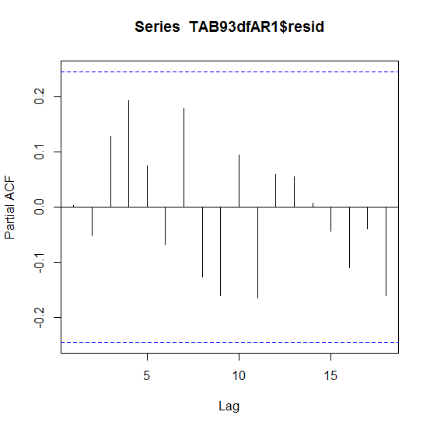
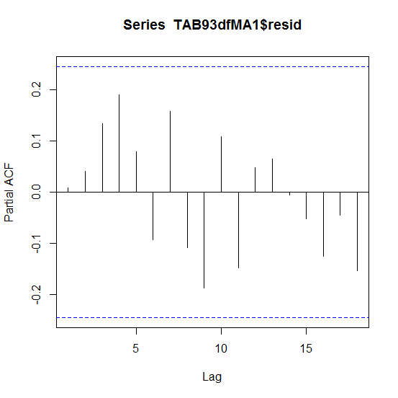
Transportation index data: ARIMA(1,1,0) and ARIMA(0,1,1) model fitting
Plots have no ‘pattern’ in either case

Slide 14
Transportation index data: ARIMA(1,1,0) and ARIMA(0,1,1) model fitting (contd.)
One line R code, assuming differenced data in Tab93df:
arima(Tab93df,order=c(1,0,0))
AR(1) model
W_{t} = 1.035 + 0.280W_{t – 1} + ε_{t}
(0.319) (0.119)
Estimated variance of ε_{t} is 3.43
AIC = 266.5
MA(1) model
W_{t} = 1.038 + ε_{t} + 0.287 ε_{t – 1}
(0.297) (0.120)
Estimated variance of ε_{t} is 3.43
AIC = 266.6
Akaike Information Criterion is used to compare parametric models (smaller AIC is better)
The models produce comparable results

Slide 15
Transportation index data: ARIMA(1,1,0) and ARIMA(0,1,1) forecasts
R code for forecasting
predict(arima(Tab93df,order=c(1,0,0)), n.ahead=1)
AR(1) model
W₆₆ = 1.372
(1.851)
Y₆₆ = Y₆₅ + 1.372
= 289.94
(1.851)
95% prediction interval:
289.94 ± 3.70
MA(1) model
W₆₆ = 1.474
(1.852)
Y₆₆ = 288.57 + 1.474
= 290.04
(1.852)
95% prediction interval:
290.04 ± 3.70

Slide 16
Transportation index data (continued)
If constant term in differenced series is not used, differencing, model fitting and forecast generation can be combined into a single step
predict(arima(Tab93,order=c(1,1,0)), n.ahead=1)
predict(arima(Tab93,order=c(0,1,1)), n.ahead=1)
Even model selection can be made automatic
library(forecast)
predict(auto.arima(Tab93), n.ahead=1)
Automatically chosen forecasting model happens to be ARIMA (0,2,1), and the AIC is smaller!

Slide 17
Revisit US retail sales data (random component)
Code to retrieve the random component
library("TTR")
Tab31A <- scan("c://Hanke/Data_Files/ascii/Ch03/Case3-1A.txt",skip=1)
Tab31Ats <- ts(Tab31A, frequency=12, start=c(1983,1))
Tab31ACompMult <- decompose(Tab31Ats, type = "multiplicative")
Code to fit an ARMA model automatically
auto.arima(Tab31ACompMult$random)
This program chooses an ARIMA(0,0,0) model.

Slide 18
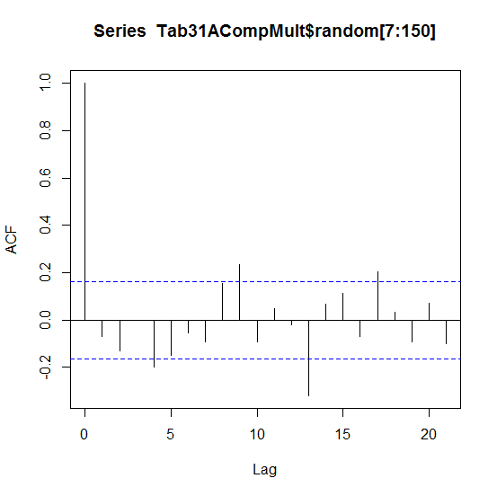
Analysis of US retail sales data (random component)
Why does this happen?
Correlogram is not benign
Even Ljung-Box test (code given below) indicates that there are some non-zero ACFs
Box.test(Tab31ACompMult$random[7:150], lag=20, type="Ljung-Box")

Slide 19
Analysis of US retail sales data (random component)
There is no clear way to use the information in the random component.
Exponential smoothing:
HoltWinters(Tab31ACompMult$random[7:150], beta=FALSE, gamma=FALSE)
produces a alpha = 0.03 (a lot of smoothing).
Forecast contribution, obtained by the code:
forecast.HoltWinters(HoltWinters(Tab31ACompMult $random[7:150], beta=FALSE, gamma=FALSE), h=1)
is negligible (a factor of 1.0003).
Eventual forecast has to rely on the trend and seasonal components only.

